Slide 1

Improving Pro Bono Client Experience at
Team X -
Alejandro Herrera, Himanshu Kumar, Lida Tetyusheva

Slide 2
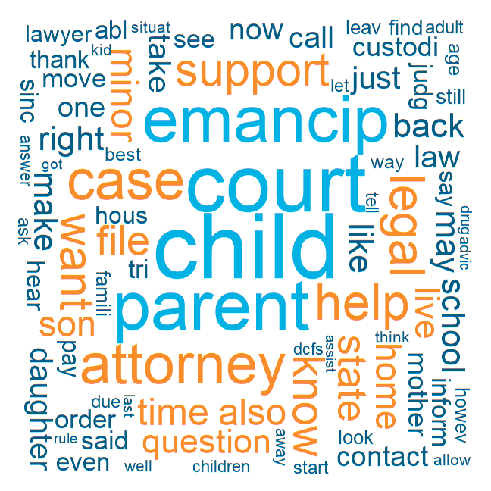
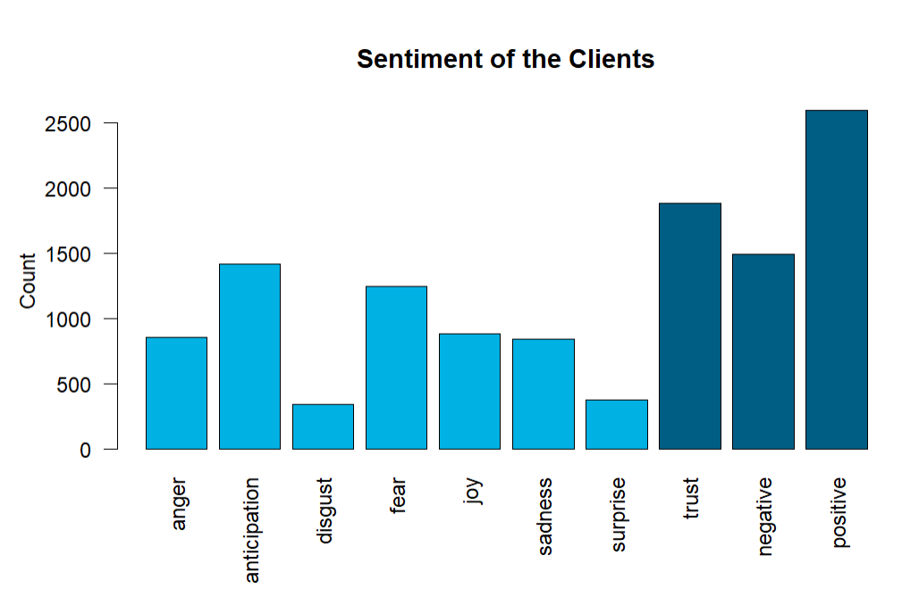
Sentiment and Text Analysis

Slide 3
Who are the clients and what are they asking?
Top 3 Question Categories: Family and Children, Housing and Homelessness, Other
Top 5 clusters of clients had these demographics:
State | # in Household | Gender | Marital Status | Category | Below Allowed Income Limit
IN | 2 | Female | Single | Family | True
TX | 3 | Female | Separated | Family | True
FL | 1 | Female | Single | Family | False
IL | 4 | Female | Married | Family | True
IL | 3 | Female | Single | Other | True
Recruitment Advice: Advertise to Family and Children Attorneys that have experience with single female clients. Enable precautions that prove clients are eligible for pro bono services

Slide 4
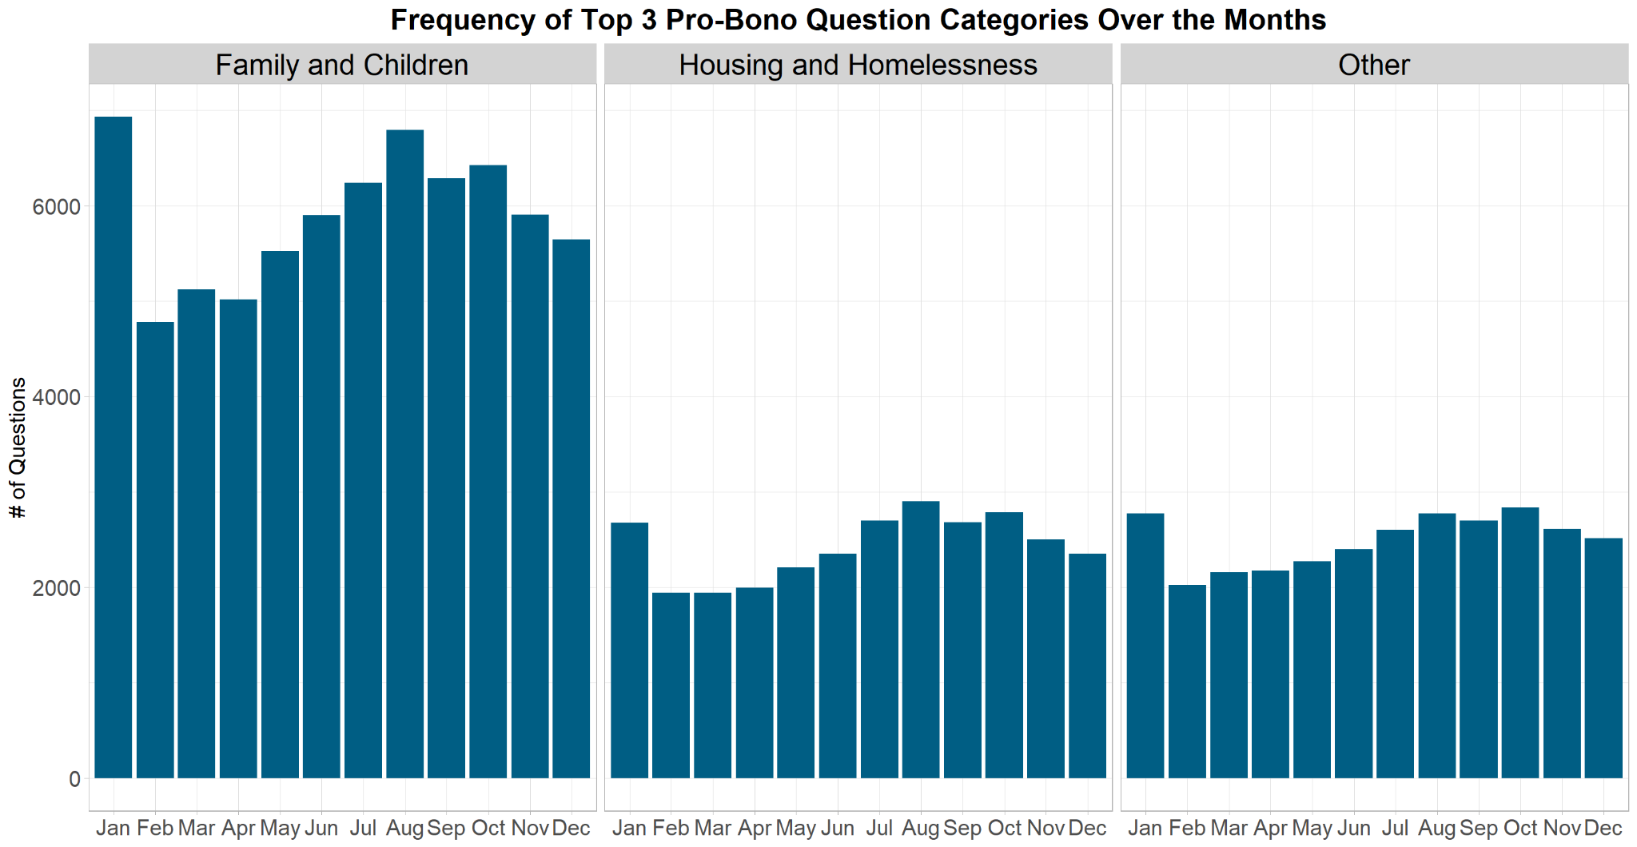
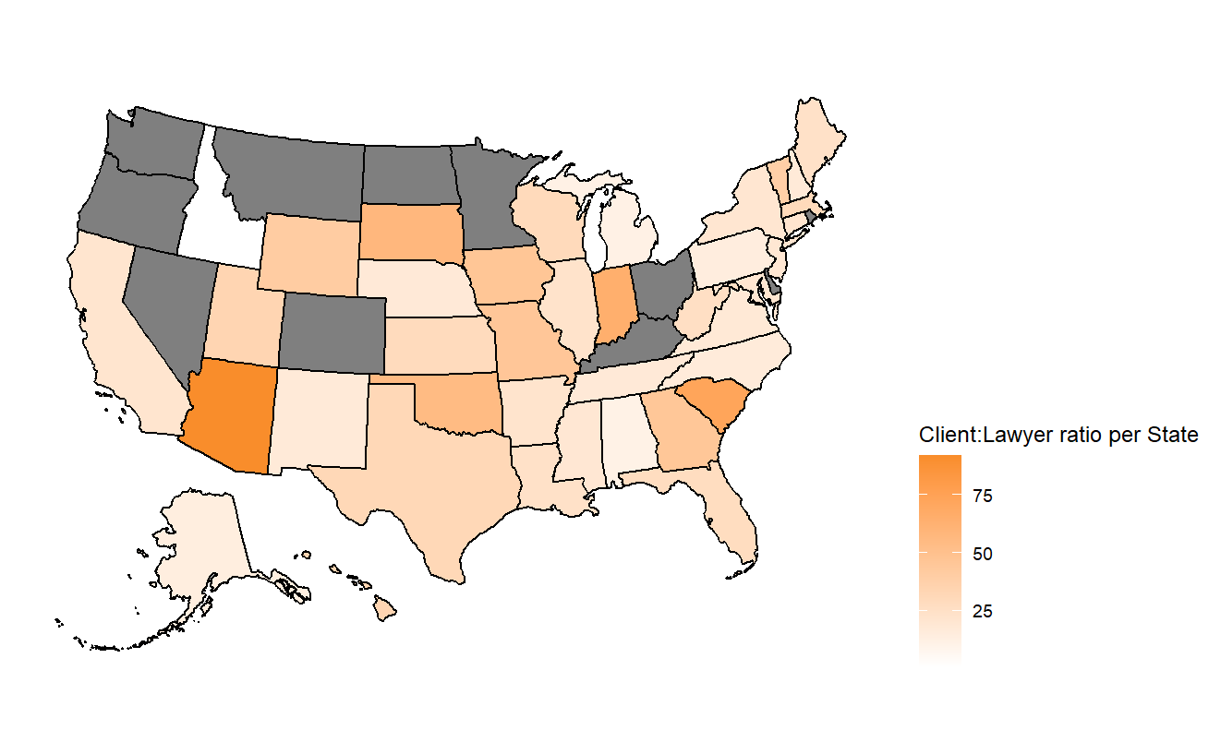
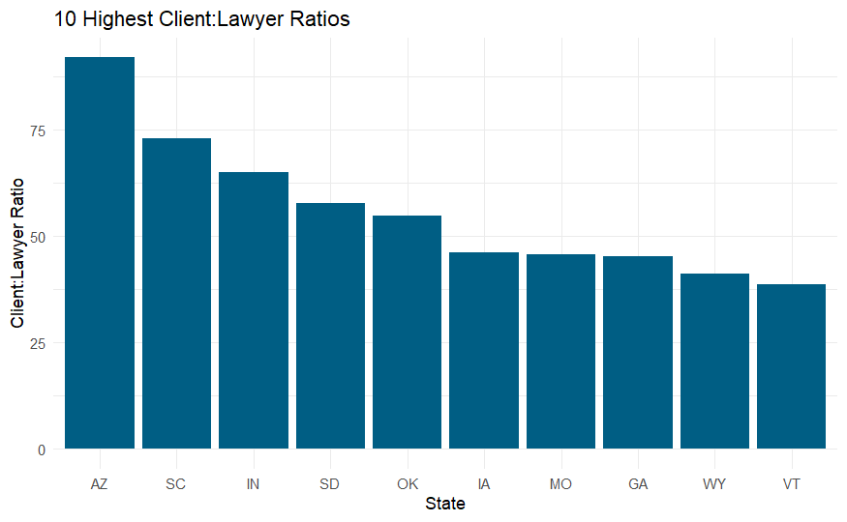
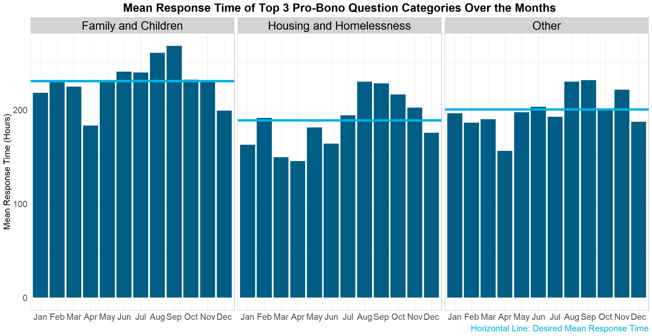
When is the need for lawyers the greatest?
Where is the need for lawyers the greatest?
Notes:
Questions that we had at the end of the project:
Why were there so many clients whose income went way over that state’s income limits. (e.g. clients making 100k+ annually)
What happened around 2016 that caused so many new lawyers to join? How about in 2020? (attorneys$CreatedUtc)

